Slide 1
Cromarty Youth Café Report for Community Council
20th September – 15th October 2021

Slide 2
Number’s
Total Number Contacts – 280
Total number of sessions - 43
Total Number of Learning Hours - 416

Slide 3
Junior Youth Café
At Jnr Youth Café we are making the most of being outdoors,
Our activities are done in consultation with young people
At every Jnr Youth Café Session young people are fed with a range of hot cooked meals and range of snacks.
All the young people really enjoy taking part in the youth café

Slide 4
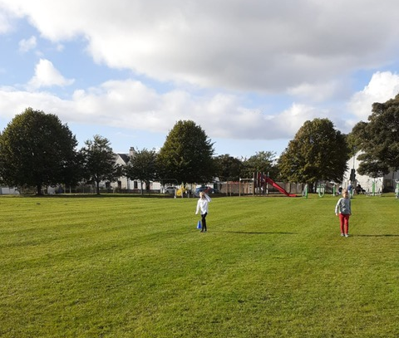
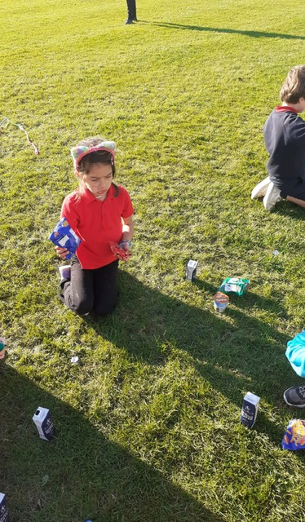
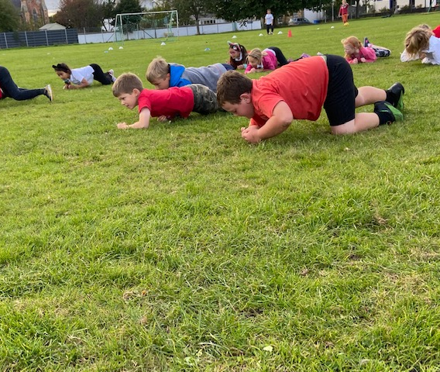
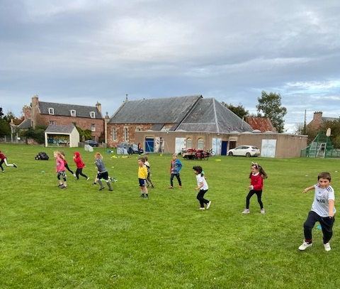
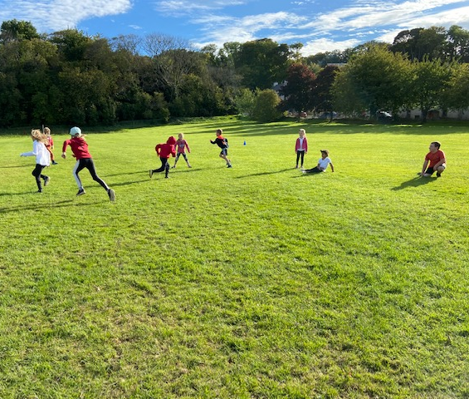

Slide 5
Senior Youth Café
At Snr Youth Café we have been going on Walk & Talks around the Village,
The final week before the holidays we were out on the Trikes,
One Young person said the best part about coming to Youth Café is the selection of food on offer

Slide 6
Trip out The Trikes

Slide 7
Football Coaching with ICT
Each week 25+ young people attend for football coaching
The young people are improving each week with skills & drills,
The young leaders who support football coaching are learning lots of new skills, learning how to work as part of team. Ball Control,

Slide 8
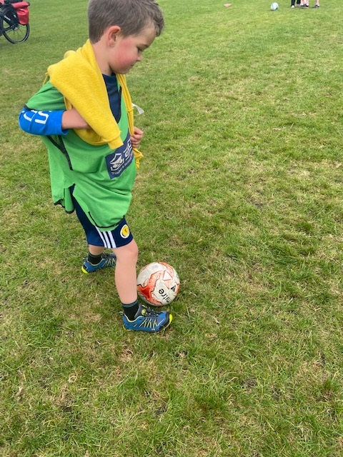
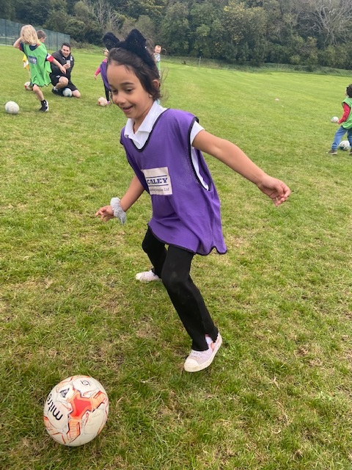
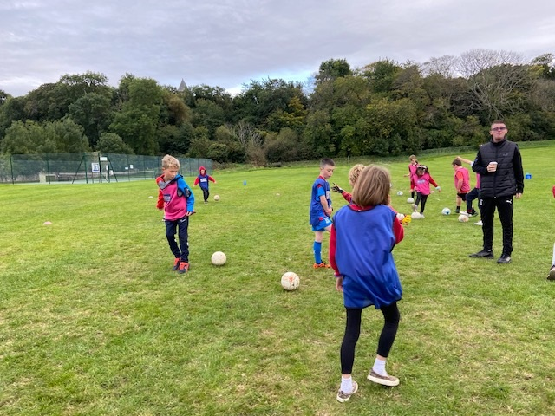

Slide 9
Rowing
5 sessions of youth rowing happen each week.
Young People supported with the planning of Cromarty Community Rowing Club Regatta 2021.
They competed in:
Under 15 team won Gold
Under 17 team won Silver
The young people enjoy taking part in rowing and are always willing to fill in if someone is missing,

Slide 10
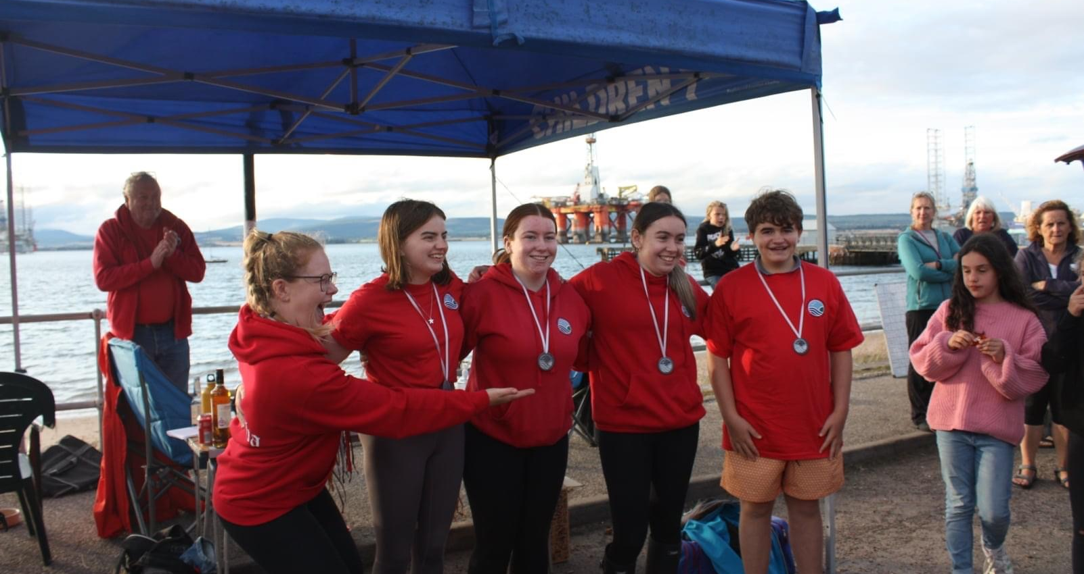
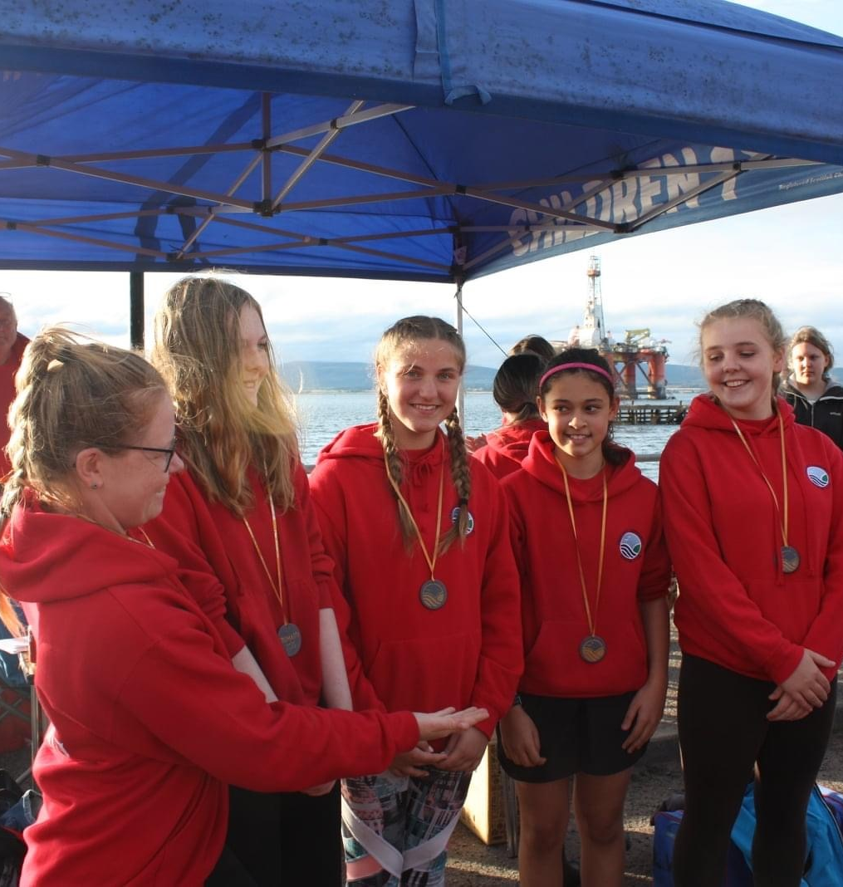
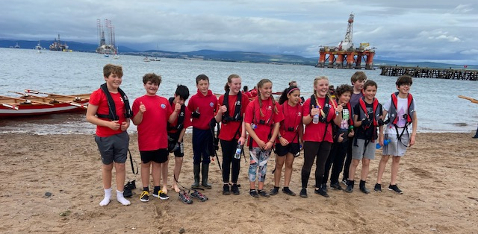

Slide 11
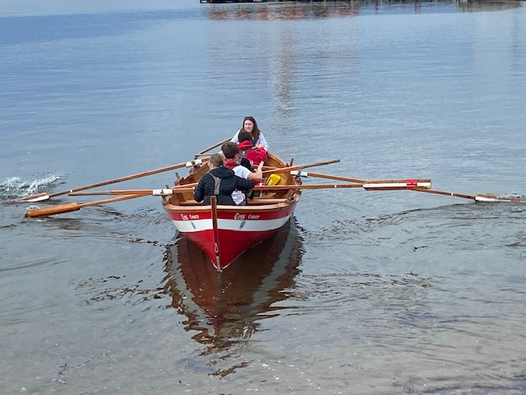
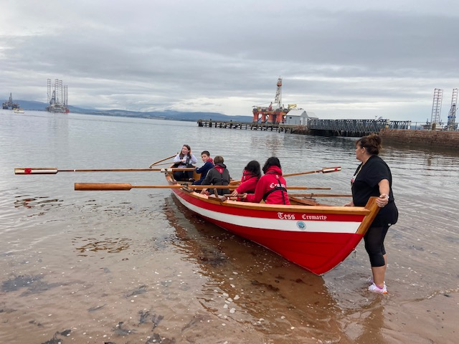

Slide 12
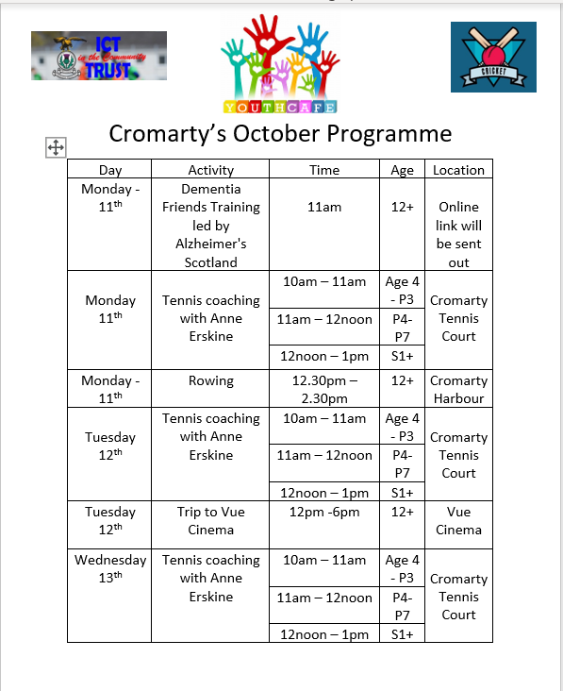
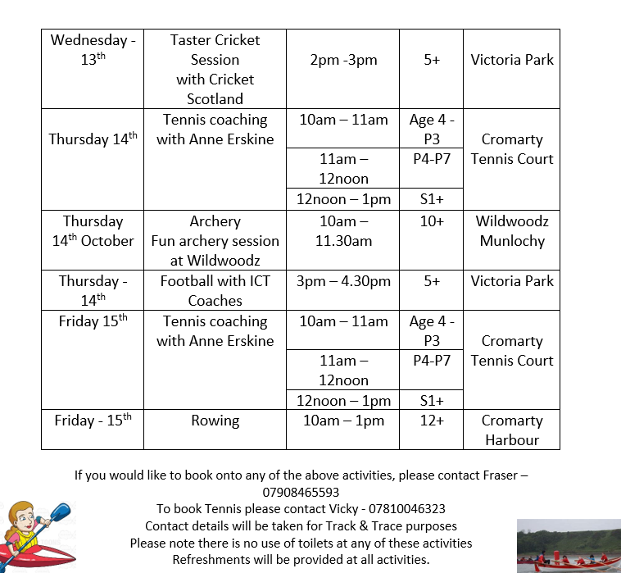

Slide 13
Dementia Friends Training
We took part in Dementia Friends Training with Hayley Lyons, Dementia Advisor from Alzheimer's Scotland, she works with people who have dementia or works with families that are affected by dementia. Hayley is also a Dementia Friends Trainer
We learned about how to help people who have dementia and learned about different types of Dementia and that Dementia is an umbrella term. This means that it is not one type but many types of Dementia.

Slide 14
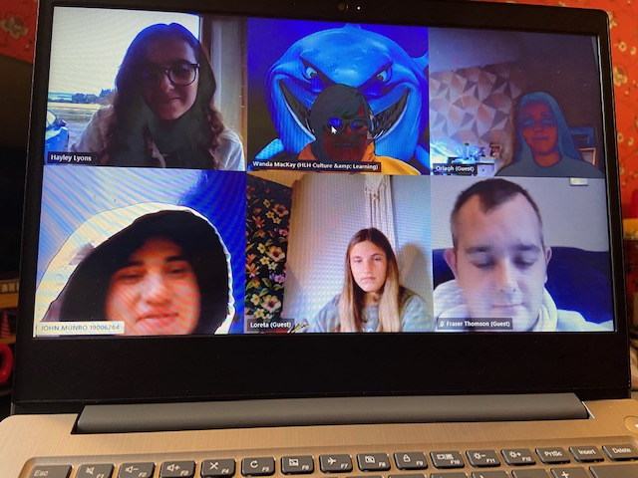

Slide 15
Tennis Coaching
Tennis Coaching happened each day with Tennis Coach Anne Erskine from Inverness Tennis Club
The young people really enjoyed the coaching and improved their skills each day.

Slide 16
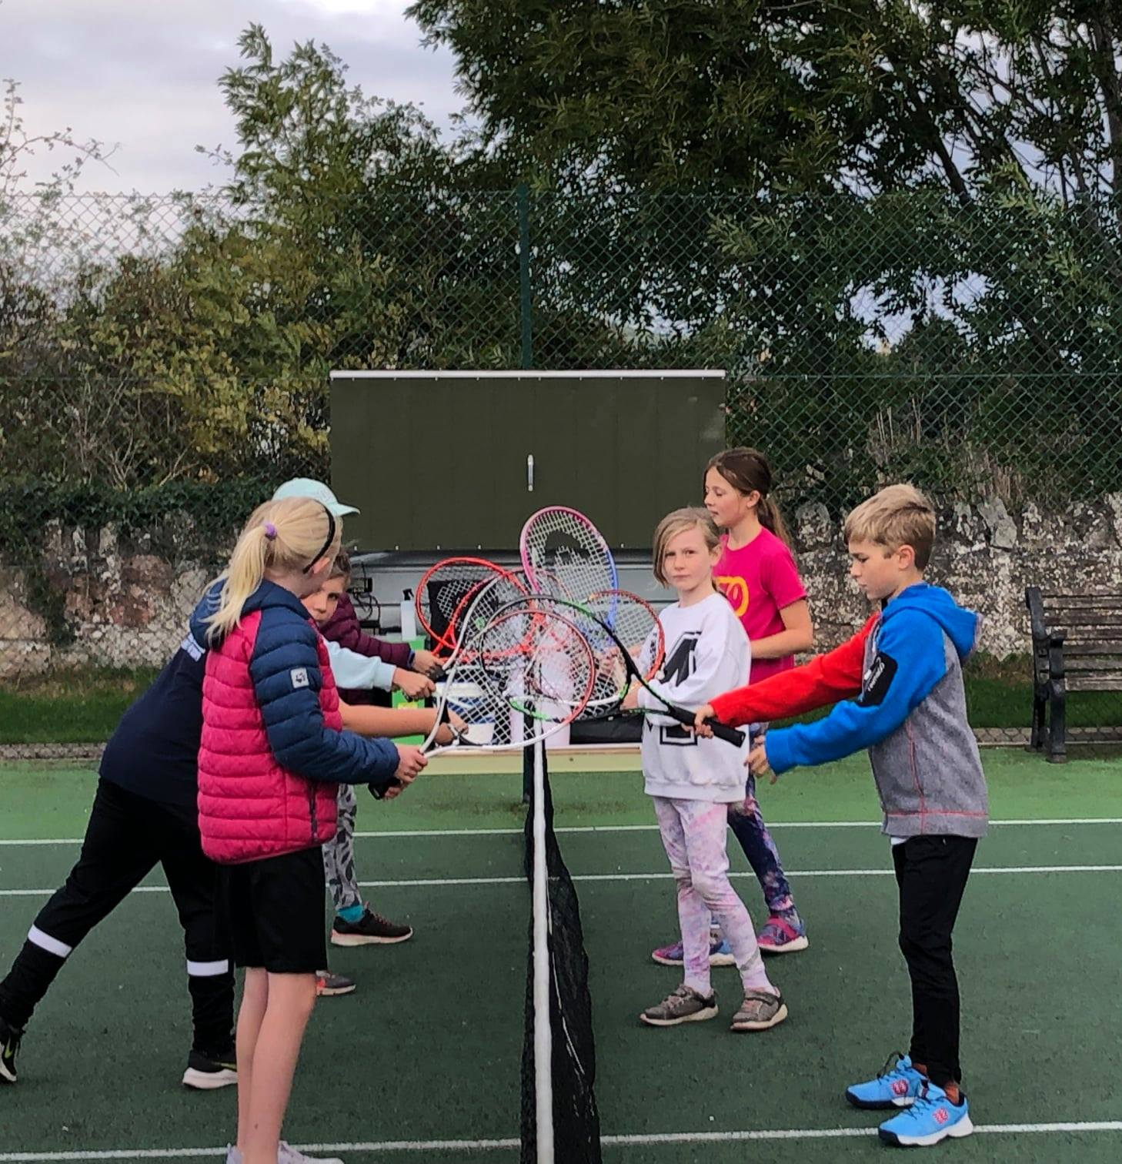
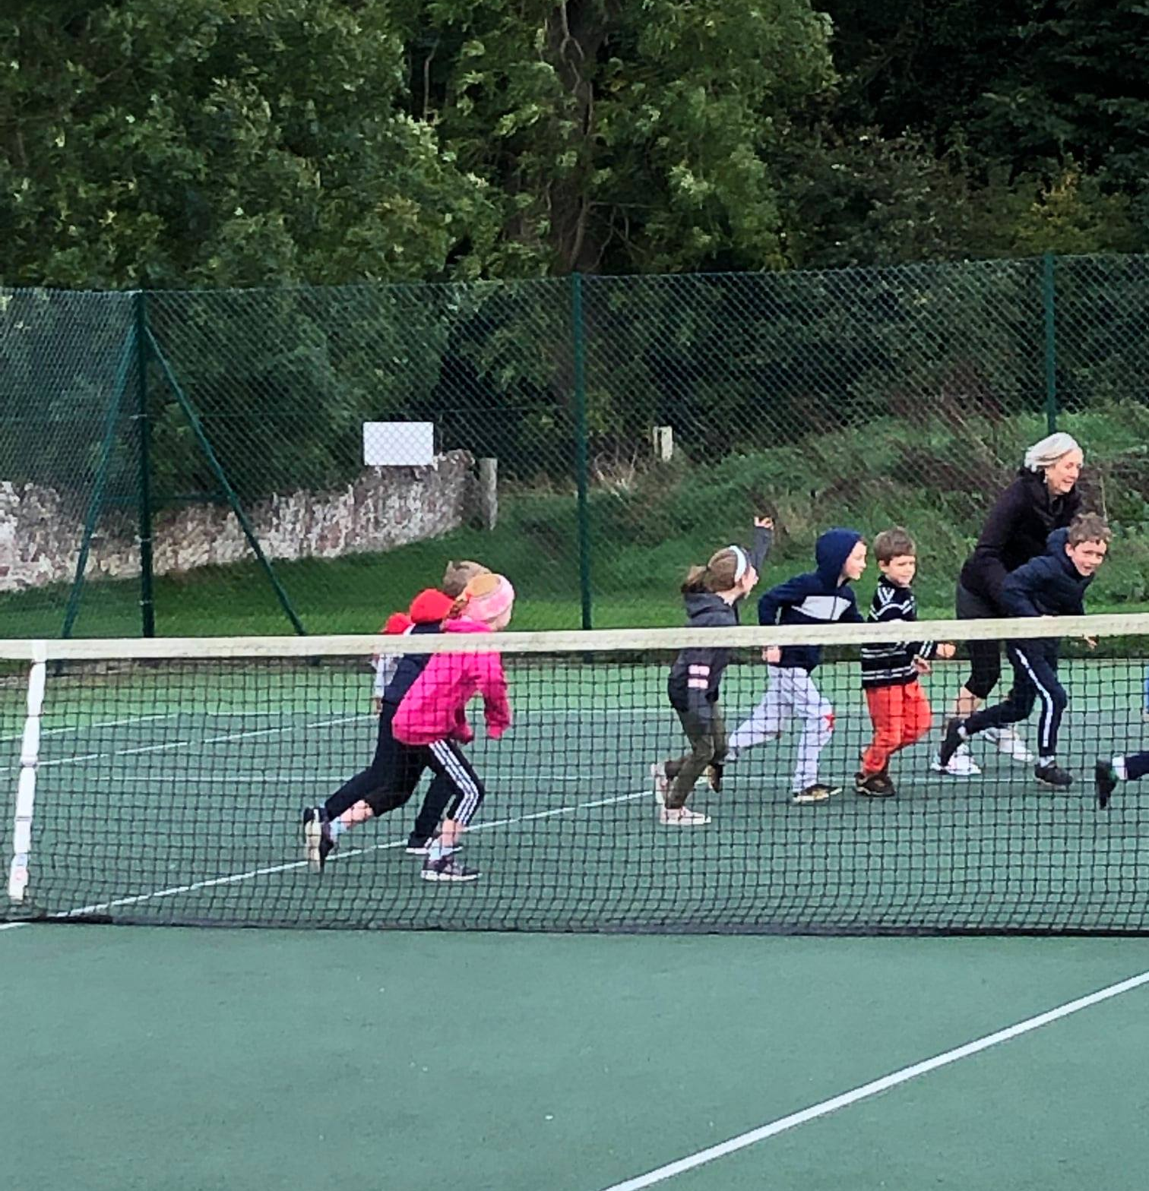

Slide 17
Trip to Vue Cinema & Pizza Hut
This was a day out for our young volunteers – to say a huge thank you for all the support they give to the youth café
This was also for John Munro who was a Finalist with Young Scot, this was meant to be an awards ceremony in Edinburgh but due to COVID it was cancelled.
We went to See No Time To Die and then to Pizza hut for dinner,
We would have gone to Cromarty Cinema but couldn’t get tickets for this

Slide 18
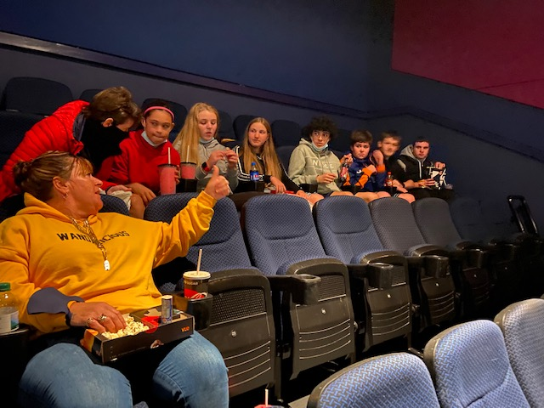
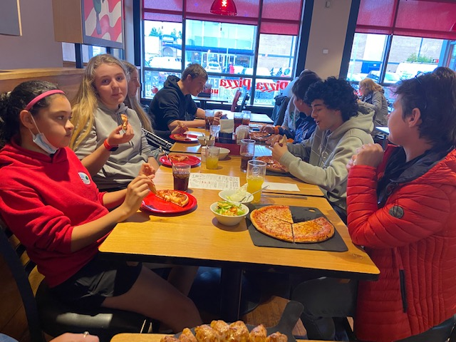

Slide 19
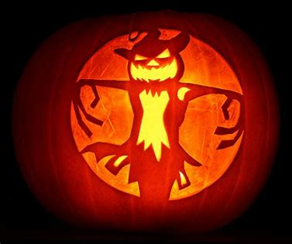
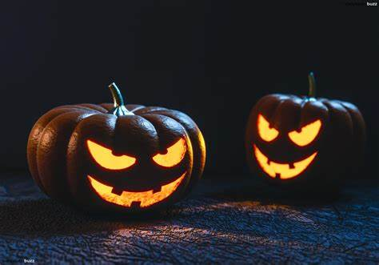
Halloween Crafts
The young people decorated plates mugs and glass jars for taking home
Young people also got to decorate Halloween masks for costumes masks were pumpkins, witches, ghosts and a buffalo
Also young people decorated gingerbread people for intergenerational afternoon.

Slide 20
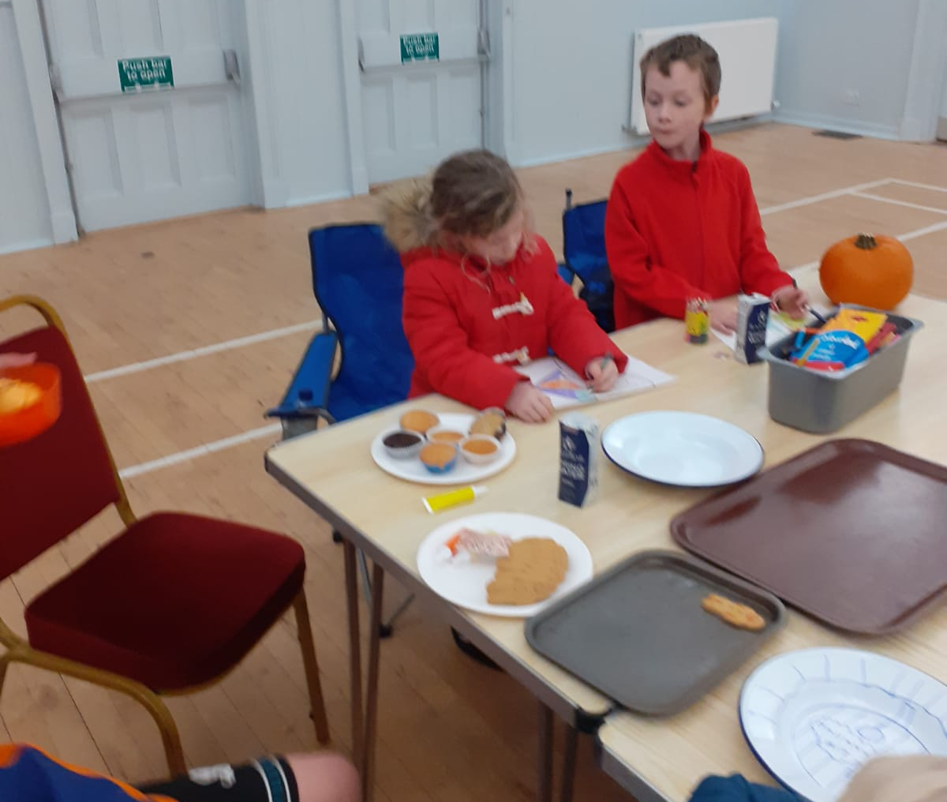
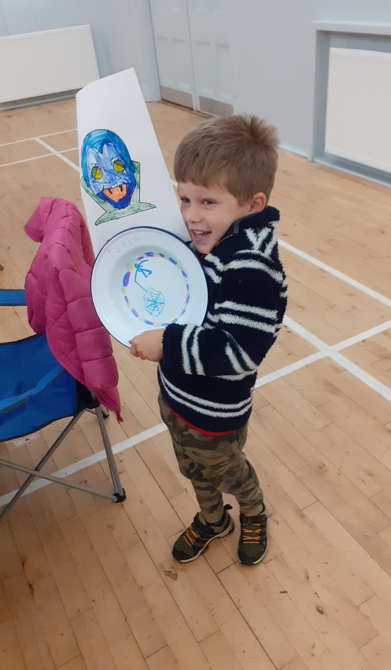
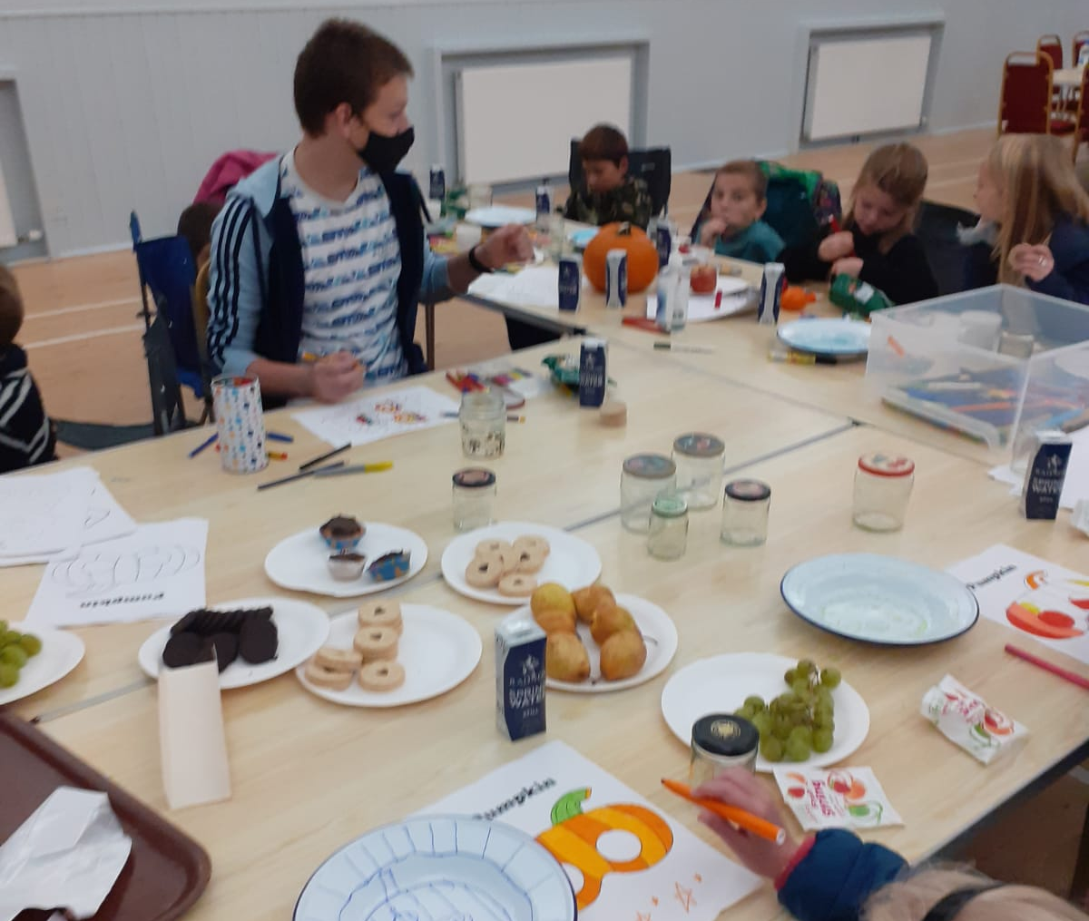
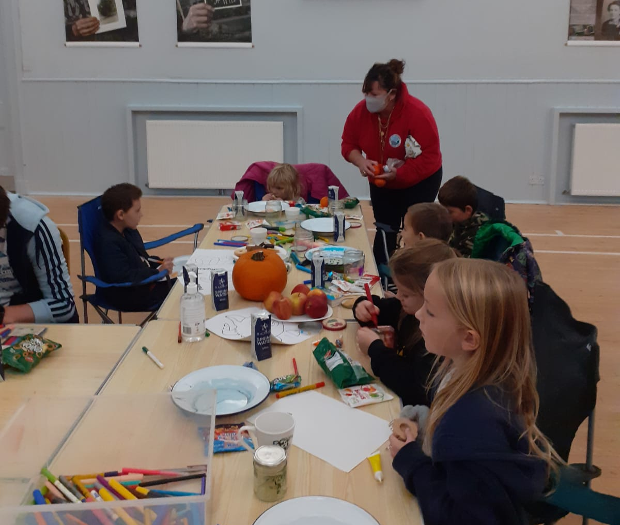
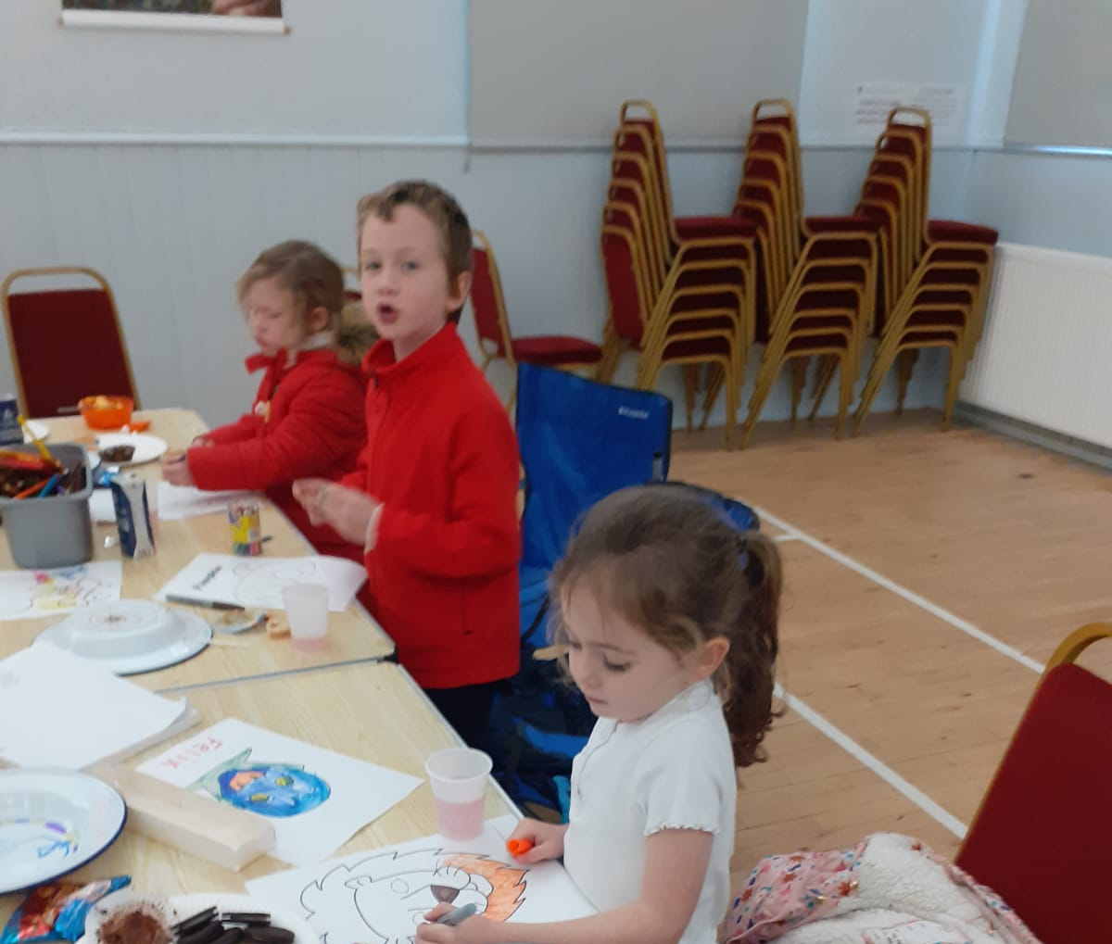

Slide 21
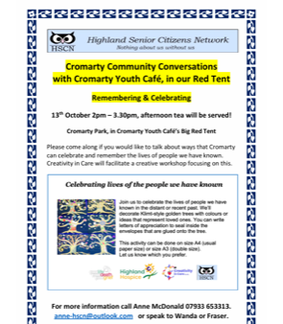
Intergenerational Afternoon
We had a session with Creativity in Care, Talking about Remembering Loved ones and Celebrating them.
Painting Pictures with a message for a loved. Using the Klimt-Style Golden Thread.

Slide 22
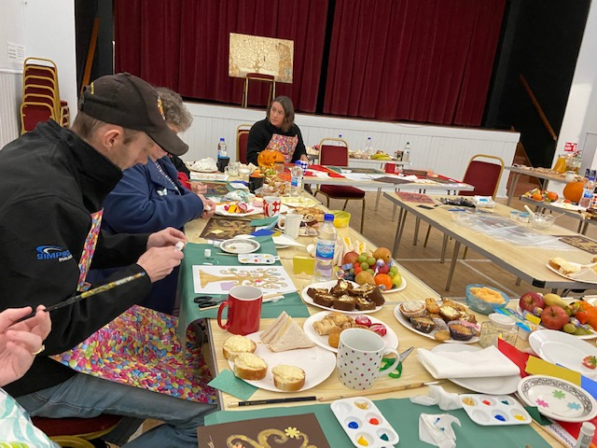
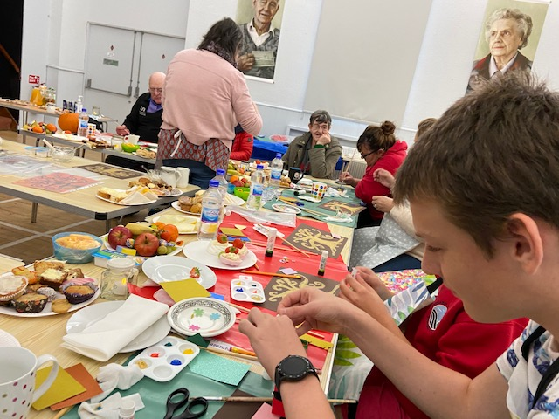

Slide 23
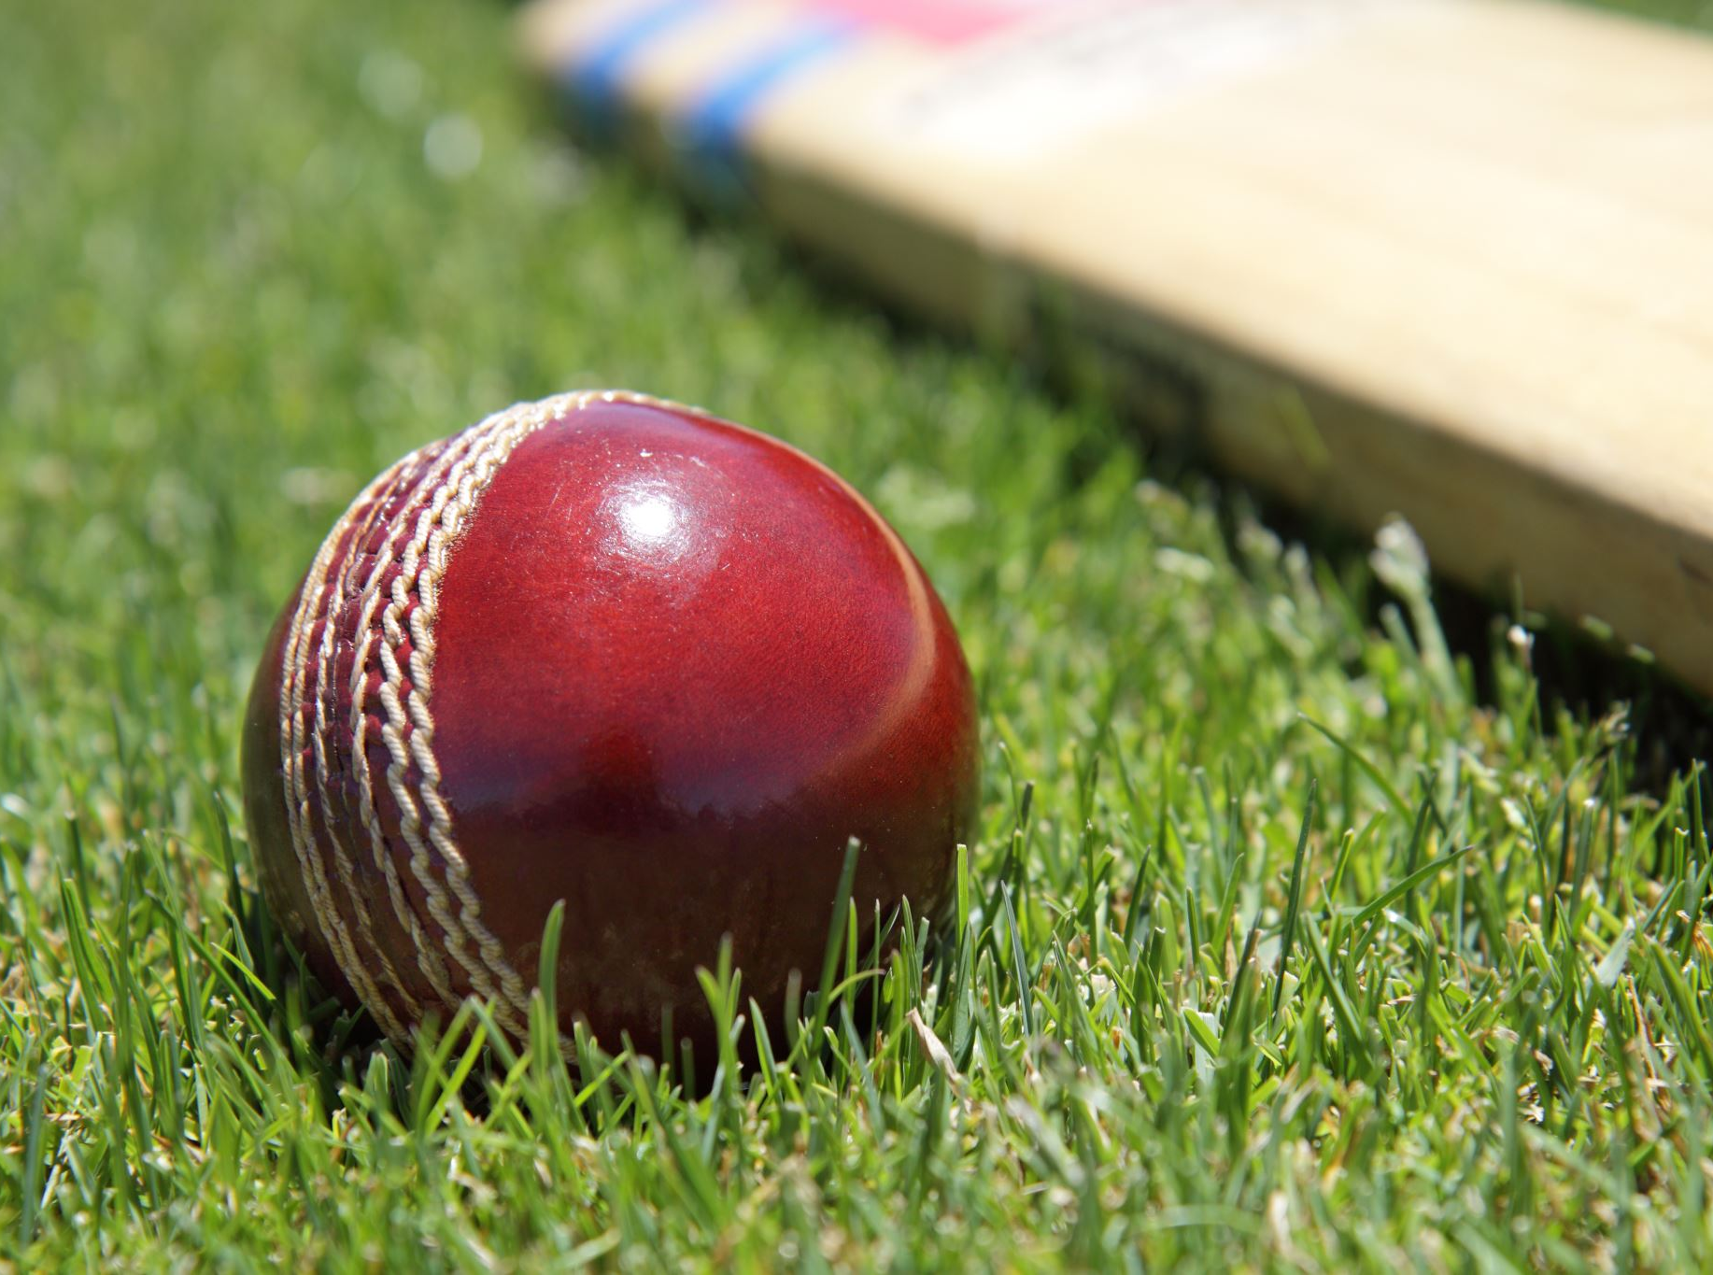
Taster Cricket Session
This session was delivered Northern Cricket Alliance give a demonstration about cricket
The young people learnt about the cricket equipment, and what the aim of Cricket is.
The young people, liked the session as it was exciting,
FH said, “I loved the session, and it was something I never done before.”

Slide 24
Archery at Wildwoodz
To start the session, we were given a safety briefing for how to use the bow and how to shoot the arrow and to collect the arrow safely.
Then in 2 groups for the first 3 times we did a target practice, then it was on to a competition to see who got the most points we did this a few times before moving on to the last game which was a zombie apocalypse.
Everyone really enjoyed the session.

Slide 25
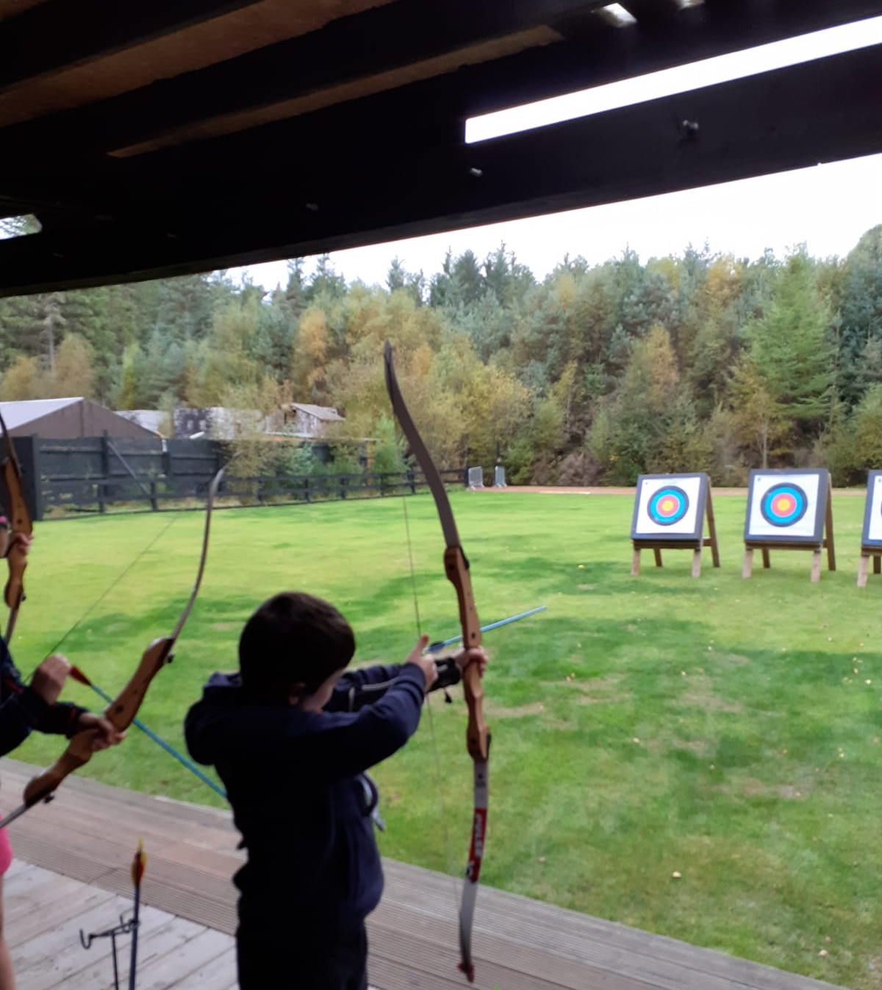
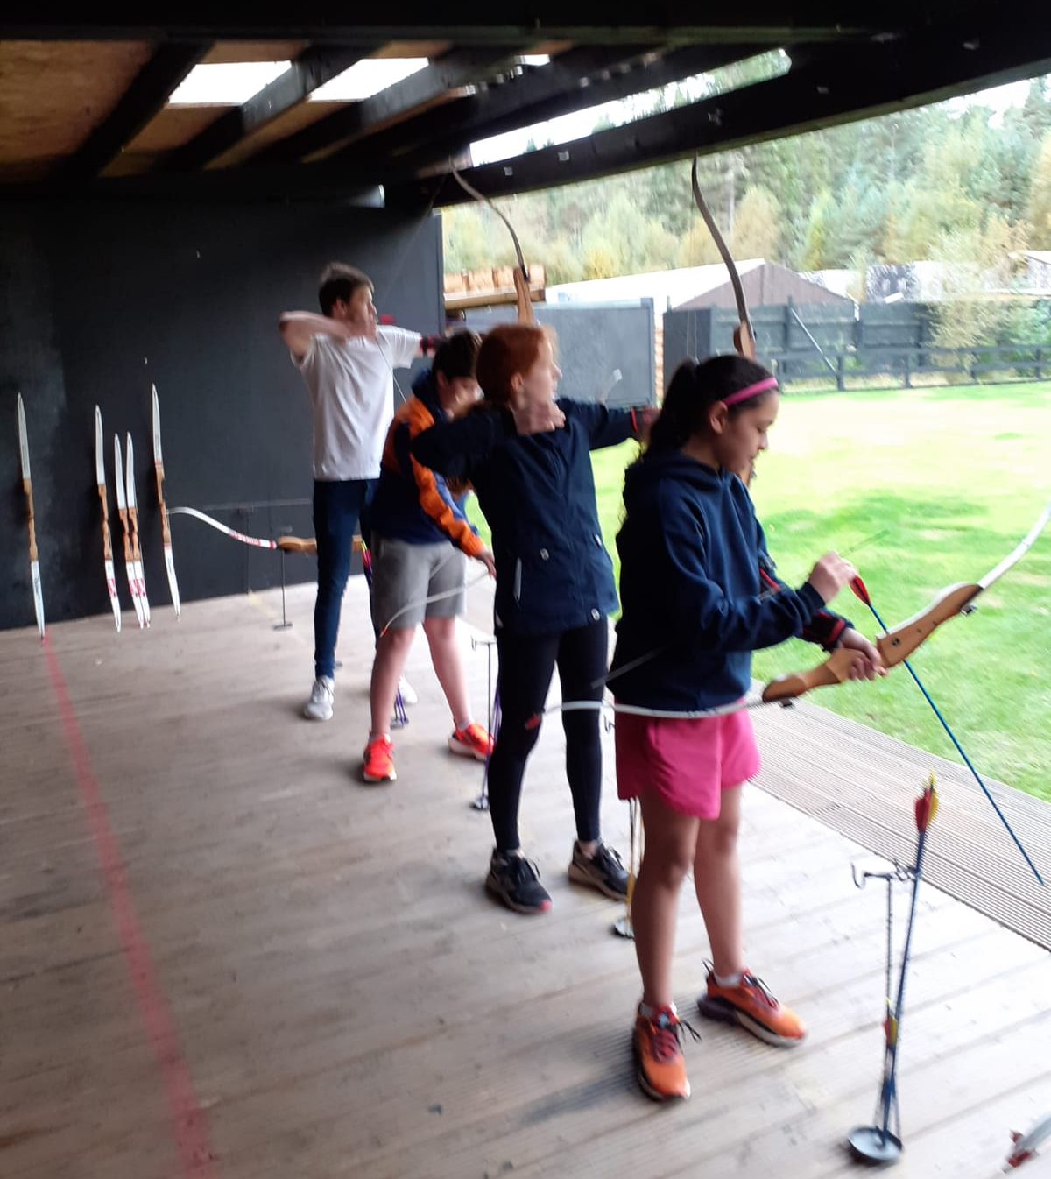

Slide 26
Football Coaching
Football coaching with Inverness Caley Thistle Youth Development Team is a huge success with around 30 young people turning up each week,
The young people are learning skills, drills, passing, scoring, teams skills, communication problem solving new rules and listening.
The young people engage really well with the coaches

Slide 27
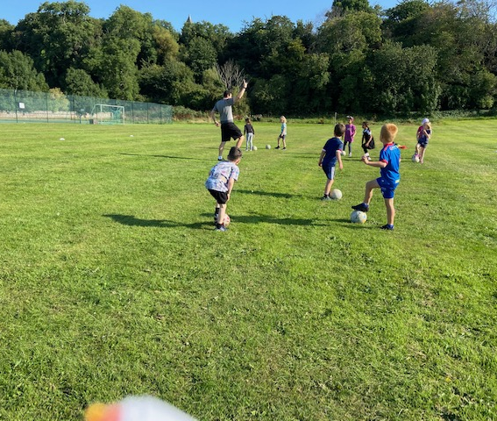
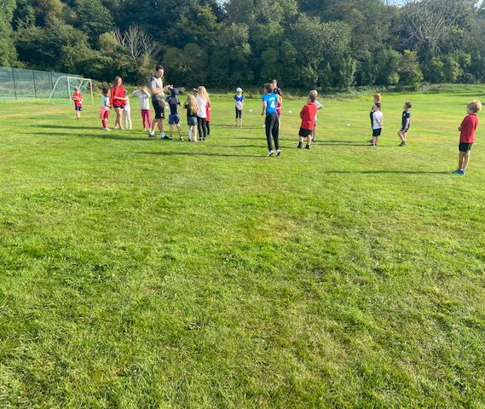
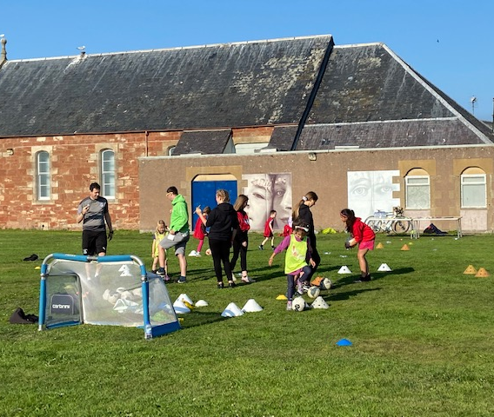
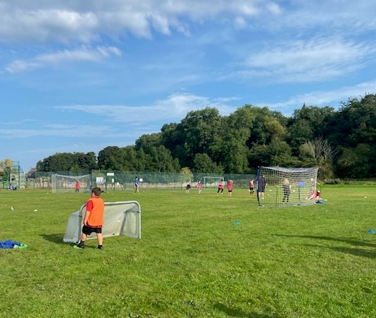
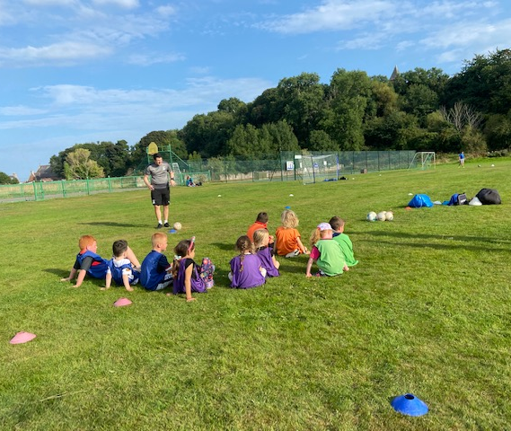
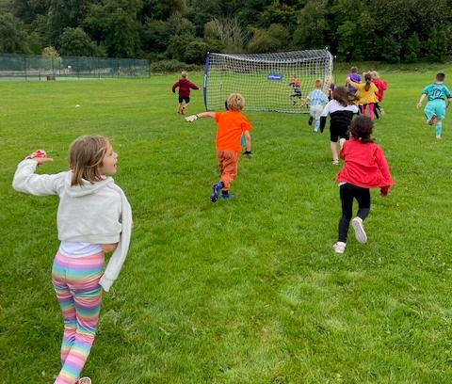

Slide 28
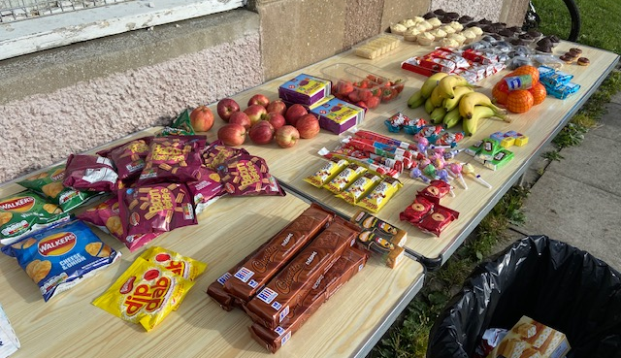
THE FOOD
Each session young people are given a deluxe buffet.
Filled with healthy snacks and nutritional meals
Wanda Cooks food at home and then delivers up to the Youth Cafe

Slide 29
Cookwell / Bakewell
On 1-1 Basis Wanda has been doing baking a cooking with EP in Fortrose Academy, they have been doing all of this for each Youth Café
He has been making a range of the different types of foods.
Due to having no cooker in the hall.

Slide 30
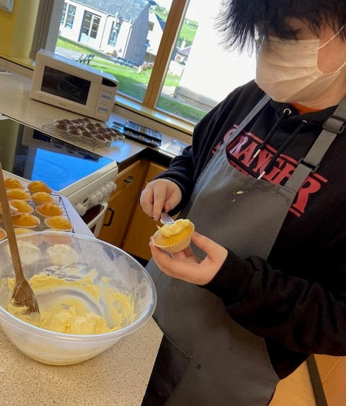
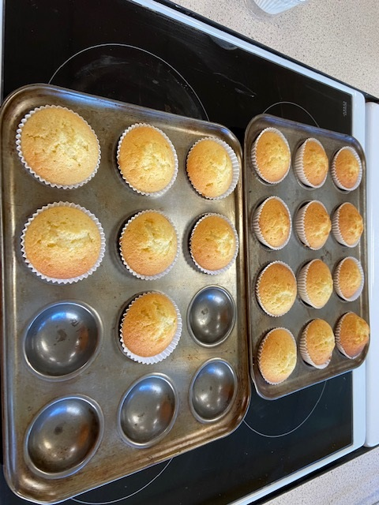

Slide 31
Resilience in Your Community / Bloom
I shadowed the group in the school that are delivering the bloom project and on the back of this, myself and John will deliver the Resilience in Your Community after October Holidays this is in partnership with Support in Mind Scotland.
Resilience in Your Community - The programme equips young people with the tools and knowledge to maintain their mental health through life’s transitions, both now and in the future

Slide 32
Background Work
Meeting with Julie from Cromarty Primary School to plan for after October Holidays, looking at delivering, Bike Ability Level 1 & 2, Resilient Kids, Junior Warden Scheme
Meeting with family in Cromarty who has 7 kids, introduction to who I am and inviting them to join out activities

Slide 33
Support from Wanda to do Funding Applciation
Funding Application to the Craigy Urquhart Trust – Successful for trip to Pantomime in December
MFR Mission Christmas
Rural Action Fund – Application for Cookwell – Successful

Slide 34
Personal Development
I am currently taking part in – International Diploma for Intergenerational Learning
I have been taking part in Conferences with Generations Working Together, to help with my studies and to support with becoming better at the intergenerational work we do

Slide 35
Saltire & Leadership
Over the last month a number of young people have been in contact with myself to sign up for Saltire Awards and Highlife Highland Leadership Awards
Some of the young people’s awards have been backdated
There has been a number of awards given out over the last month.

Slide 36
Working Group / Committees Young People and ourselves are on
Black Isle Health and Well being Focus Group
Cromarty Community Rowing Club – Wanda is the youth leader
After a suicide Subgroup – Wanda
Cromarty Community Council X 2 Reps
Highland Youth Parliament X2 Reps
Cromarty Youth Café.

